Slide 1
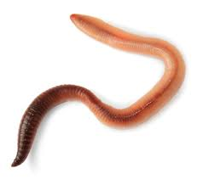
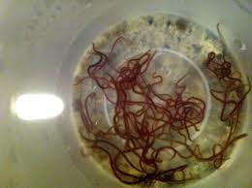
Worms
Mrs. aRusso
Grade 7- Life Science

Slide 2
General Characteristics of Worms
Slender, legless invertebrates
Have organs (digestive, reproductive, etc.)
Show bilateral symmetry (matching halves)
Have an anterior (head) and posterior (tail)
Some reproduce sexually (2 parents) and some reproduce asexually (1 parent)
Regeneration- type of asexual reproduction where organism re-grows missing parts.
Are either free-living or parasitic

Slide 3
Free living: lives on its own; independent
Parasitic: lives in or on another organism harming it in some way.
Host: the organism that a parasite lives in or on

Slide 4
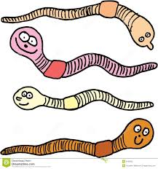
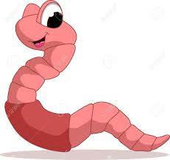
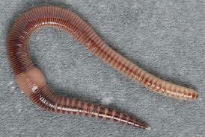
Earthworms
Earthworms are free-living
Earthworms belong to the Annelid phylum which contains the segmented worms.

Slide 5
Earthworm Anatomy
Anatomy = the study of structure or internal workings of an organism.

Slide 6
Digestive System
Responsible for breaking down food and absorbing nutrients; earthworms are “tubes within tubes” with two openings: mouth and anus

Slide 7
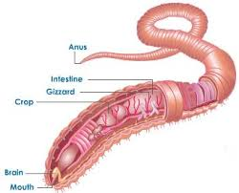
Digestive System Parts/Information
A.) Mouth- food enters here
B.) Pharynx- pulls in food
C.) Esophagus- food is moistened here
D.) Crop- Storage area for food before it gets digested
E.) Gizzard- contains small stones/sand that shred/grind up food (physical digestion)

Slide 8
Digestive System Parts/Information
F.) Intestines:
Makes up 2/3 of the digestive system’s length
Food is completely broken down and absorbed for use by the rest of the body (chemical digestion)
G.) Anus: solid waste (called castings) exits here
Peristalsis: rhythmic contractions that push food through the digestive system.

Slide 9
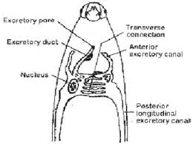
Excretory System
Responsible for getting rid of waste
Liquid waste exits through the skin

Slide 10
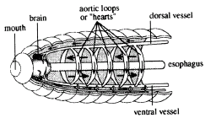
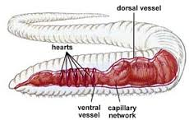
Circulatory System
Blood is pushed through two major blood vessels by the pumping of 5 sets of “hearts” (AKA aortic arches).
Blood carries nutrients absorbed from the intestines and oxygen to all parts of the body.
Blood also carries carbon dioxide.

Slide 11
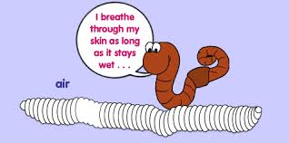
Respiratory System
Controls the intake of air
Air enters an earthworm through its skin

Slide 12
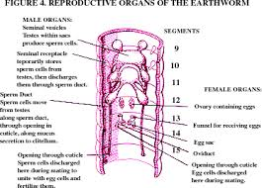
Reproductive System
Each earthworm has BOTH male and female reproductive organs.

Slide 13
Sexual Reproduction in the Earthworm
Worms have both eggs and sperm.
2 worms exchange sperm and both end up with fertilized eggs.
-----------------------------------------------------------------
Clitellum: a thick band found near the earthworm’s head. The creates a foam ring which will contain the egg and sperm.
Cocoon: this is the foam ring. Eggs and sperm unite here (fertilization). The cocoon is left behind by the worm. The young worms usually hatch from the cocoon.

Slide 14
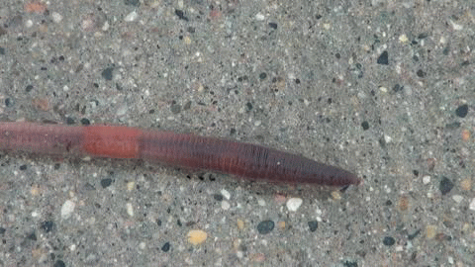
Movement
Earthworms can bend at each segment. They can move because they have two sets of muscles and setae. When one set contracts (shortens), the other set relaxes.
Setae- bristles located on each segment that are used to grip soil.

Slide 15
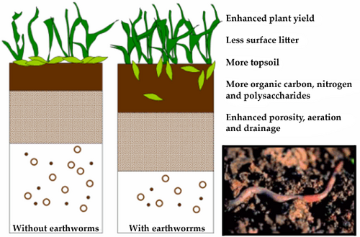
Niche
An organism’s role in the environment (AKA “job”)

Slide 16
Earthworm’s Niche
Enrich the soil through its castings
Make tunnels in the soil for water and air (helps plants)

Slide 17
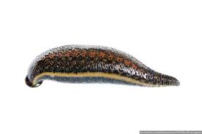
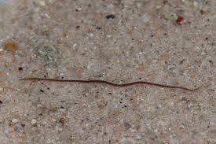
Other Examples of Segmented Worms
Leeches: parasitic
California Black worm: Freshwater, free-living worms that can asexually reproduce through regeneration. Belong to the Annelid phylum.

