Slide 1
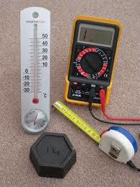
Measuring Matter
Mrs. aRusso
Team 8-1

Slide 2
Think about it: Which weighs more, a pound of bricks or a pound of feathers? Turn and Talk About it.

Slide 3
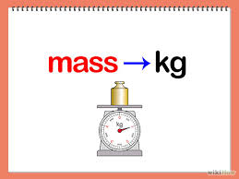
Mass
The mass of an object is the measurement of how much matter it contains.
The SI unit for mass is the Kilogram (kg).

Slide 4
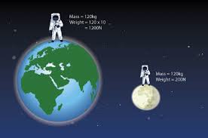
Weight
Your weight is a measure of the force of gravity on you.
Does your weight change if you were to visit the moon? Why or why not?
Does mass change with location? Why or why not?

Slide 5
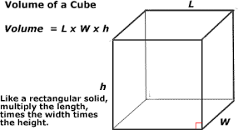
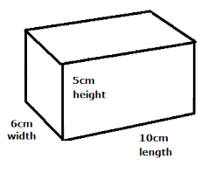
Volume
Volume is the amount of space that matter occupies.
Formula for Volume:
Volume= Length X Width X Height
Units are cubed!

Slide 6
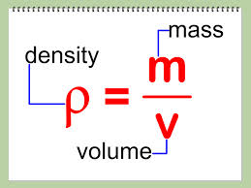
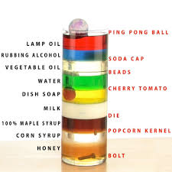
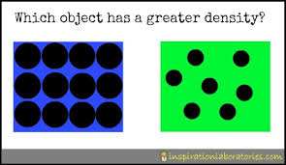
Density
Density- the measurement of how much mass of a substance is contained in a given volume.
Formula for Density:
Density=Mass/Volume
A typical unit of density is g/cm3.

