Slide 1
Characteristic Properties of Matter
Mrs. aRusso 8-1

Slide 2
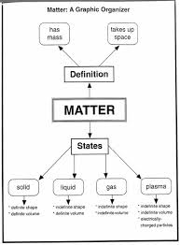
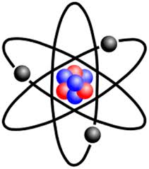
Matter
Anything that has mass and takes up space.
It is the ‘stuff’ that makes up everything in the universe.

Slide 3
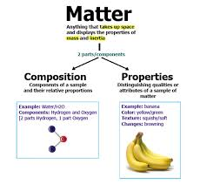
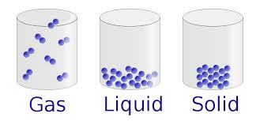
Properties of Matter
Hardness, texture, shape, temperature, flammability, size and color are all examples of properties of matter.
Matter CAN change properties! For example, water can change from a solid to a liquid to a gas and it is still water---the same substance.
Solid, liquid, and gases are the three principal states of matter.

Slide 4
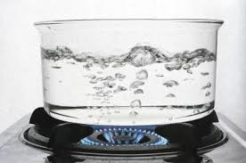
Characteristic Properties
Characteristic properties for a given substance never change, they can be used to identify unknown matter.
Examples:
Boiling Point
Melting Point

Slide 5
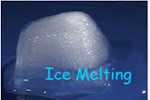
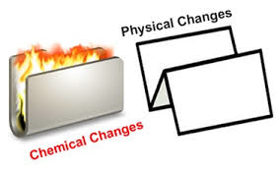
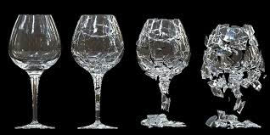
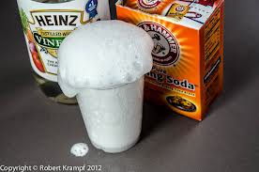
Changes in Matter
Matter can change state in one of two ways, by:
Physical Change
Chemical Change

Slide 6
Physical Change
Alters the form of a substance, but not its identity.

Slide 7
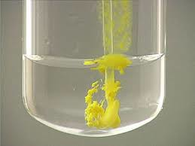
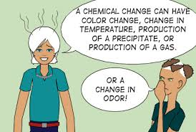
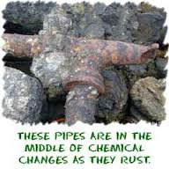
Chemical Change
Substances combine or break apart to form new substances.

Slide 8
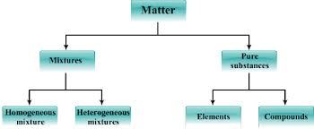
Types of Matter
Matter can be classified into two categories:
Mixtures
Pure Substances
The pure substances include elements and compounds.

Slide 9
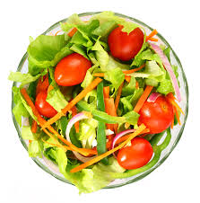
Mixture
Consists of two or more substances that are in the same place but are not chemically combined.
Solution: is the ‘best mixed’ of all possible mixtures.
Ex. Sugar water and Sea water

Slide 10
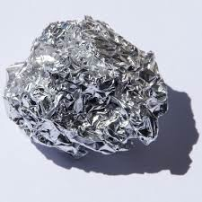
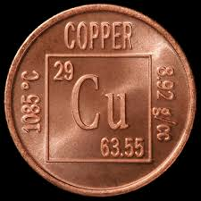
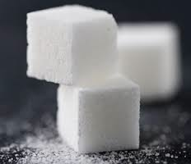
Pure Substance
A pure substance is made of only one kind of matter and has definite properties.
Examples:
Sugar, iron, aluminum and copper.

Slide 11
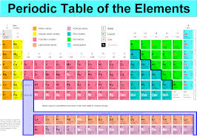
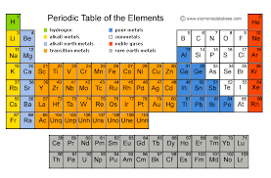
Pure Substances: Elements
Elements cannot be broken down into any other substance by any physical or chemical means.

Slide 12
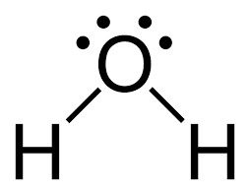
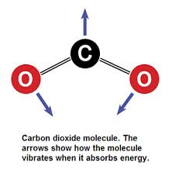
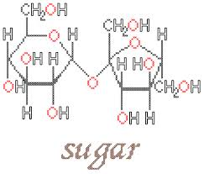
Pure Substances: Compounds
A compound is a substance made of two or more elements that are chemically combined.
Examples:
Water= H20
Carbon Dioxide= CO2
Table Sugar= C12H22O11

Slide 13
Matter Is All Around You!
Think about some objects and ask yourself questions about them. Are they solid, liquid, or gases? Which are mixtures and which are pure substances?

